Slide 1

K. S. INSTITUTE OF TECHNOLOGY BENGALURU - 560109
Affiliated to VTU, Belagavi & Approved by AICTE, New Delhi,(AccreditedbyNAAC&1E1)
Department of Computer Science and Engineering Project Phase 1 + Seminar
(15CSP78)
Behavioural Based Students Stress Detection with Attendance Management System
Batch No: 2020_CSE_23
Under the guidance of: Sharada A 1KS15CS128
Dr. Rekha B Venkatapur Laxmi K V 1KS15CS050
Prof. & Head, CSE Shashank Kavur 1KS16CS090
Adarsh Shreshta 1KS15CS125
1

Slide 2
INTRODUCTION
Student engagement has been a key topic inside the educational training.
The three specific styles of engagement of the students in a class are: behavioral, emotional, and cognitive.
The time period behavioral engagement is commonly used to describe the scholar’s willingness to participate within the getting to know system.
Emotional engagement describes a scholar’s emotional attitude toward learning.
From the facial expressions the involvement of the students in the magnificence can be decided.
Also using Face data We can Update the attendance to make the attendance process automatic.
Automatic attendance system can be monitored.
Camera will take the images of the Lecture depending on that attendance sheet will be generate.
Then camera will take images of students accordingly put the attendance.
Weekly or monthly report will send to the class teacher and parents.
2

Slide 3
LITERATURE SURVEY
Crowd Counting: A Survey of Machine Learning Approaches
Crowd counting is applied in many areas including efficient resources allocation and effective management of emergency situations. In the proposed work, we survey and compare various crowd counting methods. Additionally, we identify the limitations of existing approaches and sketch an agenda for future work to address the identified open research challenges. Furthermore, we present an enhanced deep learning-based solution for crowd counting at bus stops.
The Effect of Crowding on Visit Ratio at an Product Area: Based on RFID Data in a Japanese Supermarket
Crowding is often described as an important environmental factor in consumers' evaluations of service experiences. Prior research identifies that crowding is significantly influence with customers' in-store purchases such as the customer satisfaction, purchase intention, and purchase number.
As the author TadasBaltrusaitis, said in his literature“Automatic facial expression analysis”,like in the saying “FACE IS THE INDEX OF MIND”
3

Slide 4
SURVEY PAPER
Attendance management system using hybrid face recognition techniques
Published in: 2016 Conference on Advances in Signal Processing (CASP)
Date of Conference: 9-11 June 2016
Date Added to IEEE Xplore: 17 November 2016
Authors: Nazare Kanchan Jayant, Surekha Borra
Attendance recording of a student in an academic organization plays a vital role in judging students performance. As manual labor involved in this process is time consuming, an automated Attendance Management System (AMS) based on face detection and face recognition techniques is proposed in this paper. The system employs modified Viola-Jones algorithm for face detection, and alignment- free partial face recognition algorithm for face recognition. After successful recognition of a student, the system automatically updates the attendance in the excel sheet. The proposed system improves the performance of existing attendance management systems by eliminating manual calling, marking and entry of attendance in institutional websites.
4

Slide 5
PROBLEM IDENTIFICATION
The challenges of face recognition are the rapid and accurate identification or classification of a query image.
Some difficulties in face recognition are identifying similar faces (inter-class similarity) and intra-class variability as head pose, illumination condition, facial expression and aging effect.
The performance of a face recognition technique should be able to produce the results within a reasonable time.
PROBLEM STATEMENT:
The aim of this project is to create a system that will automatically identify the behavorial analysis & attendance of students using face recognition system.
5

Slide 6
PROJECT GOALS
To design a system it will take automatic attendance system.
Update attendance with respective to lecturer period.
Send weekly or monthly report to the class teacher , Parents and HOD.
Emotion recognition using facial expression.
Depending on the expression we need to identify the behaviour of the student.
6

Slide 7
BLOCK DIAGRAM OF FACE RECOGNITION
7

Slide 8
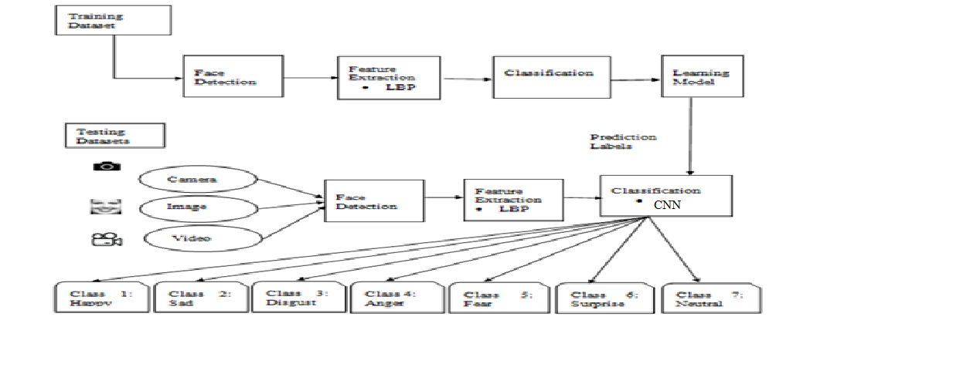
BLOCK DIAGRAM OF EMOTION DETECTION
8

Slide 9
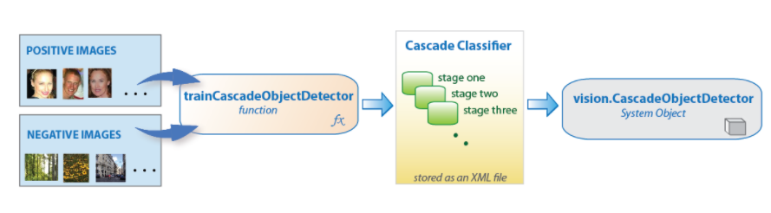
METHODOLOGY :HAAR CASCADE
Haar Cascade is a machine learning object detection algorithm used to identify objects in an image or video
It is a machine learning based approach where a cascade function is trained from a lot of positive and negative images. It is then used to detect objects in other images.
It is well known for being able to identify almost any object.
First step is to collect the Haar Features. A Haar​ feature considers adjacent rectangular regions at a specific location in a detection window, sums up the pixel intensities in each region and calculates the difference between these sums.
8

Slide 10
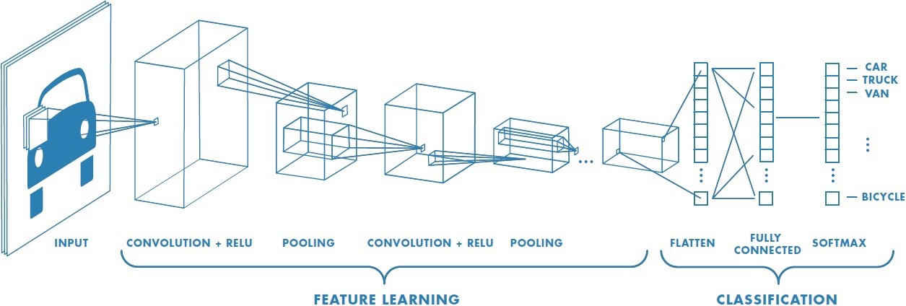
CNN(Convolutional neural network ) algorithm
• In this work, We are using CNN classifier. The classifier is utilized for the classification of the Image Fusion and Recursive Filtering features
• A convolution multiplies a matrix of pixels with a filter matrix or ‘kernel’ and sums up the multiplication values. Then the convolution slides over to the next pixel and repeats the same process until all the image pixels have been covered.
9

Slide 11
Loading the dataset
• We will plot the first image in our dataset and check its size.
• By default, the shape of every image in the mnist dataset is 28 x 28, so we will not need to check the shape of all the images. When using real-world datasets, you may not be so lucky. 28x 28 is also a fairly small size, so the CNN will be able to run over each image pretty quickly.
Data pre-processing
• We need to ‘one-hot-encode’ our target variable. This means that a column will be created for each output category and a binary variable is inputted for each category.
• Our first layer also takes in an input shape. This is the shape of each input image, 28,28,1 as seen earlier on, with the 1 signifying that the images are greyscale.
10

Slide 12
Compiling the model
• Next, we need to compile our model. Compiling the model takes three parameters: optimizer, loss and metrics.
• The optimizer controls the learning rate. We will be using ‘adam’ as our optmizer. Adam is generally a good optimizer to use for many cases. The adam optimizer adjusts the learning rate throughout training.
• After loading of the hyperspectral images the hyperspectral images are spectrally partitioned into 4 th subsets of adjacent bands i.e, Band 1, Band 2, Band 3,Band 4.
• After fusing hyperspectral image by using Transformation and Principle Component Analysis Image Fusion Techniques then I used Transform domainRecursive Filtering for filtering the fused image.
Training the model
• Now we will train our model. To train, we will use the ‘fit()’ function on our model with the following parameters: training data (train_X), target data (train_y), validation data, and the number of epochs.
• For our validation data, we will use the test set provided to us in our dataset, which we have split into X_test and y_test.
• Now we will be using our model to make predictions.
11

Slide 13
Requirement Analysis
System : intel i3/i5 2.4 GHz.
Hard Disk : 500 GB
Ram : 4/8 GB
Operating system : Windows 7/10.
Software Tool : Open CV Python
Coding Language : Python
Toolbox : Image processing toolbox.
12

Slide 14
EXPECTED OUTCOMES
Face Detection
Attendance in Excel file
Weekly report send to mail
Individual Attendance marking
Face expression detection.
13

Slide 15
APPLICATIONS
Colleges.
Companies.
Institutions.
14

Slide 16
REFERENCES
[1] HamedMonkaresi, Nigel Bosch, Rafael A. Calvo, Sidney K. D&#39;Mello, “Automated Detection of Engagement using VideoBased Estimation of Facial Expressions and Heart Rate” IEEE Transactions on Affective Computing vol.8, no. 1 (2017) 15-28, January 2017
[2] Nigel Bosch, Sidney K. D’Mello, RyanS. Baker ,Jaclyn Ocumpaugh, Valerie Shute, Matthew Ventura, Lubin Wang, WeinanZhao, “Detecting Student Emotions in Computer-Enabled Classrooms” Proceedings of the Twenty-Fifth International Joint Conference on Artificial Intelligence (IJCAI-16), 4125-4129, July 2016
[3] Tobias Kärner and Kristina Kögler, “Emotional states during learning situations and students self-regulation:process-oriented analysis of person-situation interactions in the vocational classroom” Springerplus. 2016 DOI 10.1186/s40461 - 016-0038-8
[4] NabeelaAltrabsheh, “Sentiment analysis on students’ real-time feedback”thesis, February 2016. [5] TadasBaltrusaitis, “Automatic facial expression analysis” ISSN 1476-2986, April 2014
[5] TadasBaltrusaitis, “Automatic facial expression analysis” ISSN 1476-2986, April 2014
[6] Jacob Whitehill, ZewelanjiSerpell, YiChing Lin, Aysha Foster, and Javier R.Movellan, “The Faces of Engagement: Automatic Recognition of Student Engagement from Facial Expression” IEEE Transactions on Affective Computing, vol. 5, no. 1 (2014), 86-98 January 2014
[7] Nabeela Altrabsheh, MihaelaCocea , and SanazFallahkhair, “Learning Sentiment from Students Feedback for Real-Time Interventions in Classrooms” Adaptive and Inteeligent Systems, vol. 8779, Springer, 2014.
[8] Mohamed Sathik and Sofia G Jonathan, “Effect of facial expressions on student’s comprehension recognition in virtual educational environments” Springerplus, vol. 2, no.1 (2013) 455 , December 2013
[9] Joseph F. Grafsgaard, Joseph B. Wiggins, Kristy Elizabeth Boyer, Eric N. Wiebe, James C.Lester, “Automatically Recognizing Facial Expression: Predicting Engagement and Frustration”Conference on Educational Data Mining, July 2013
[10] Mrs Stella Muchemwa, “Use of Nonverbal Communication in the Classroom as a Way of Enhancing Classroom Teaching: A Case Study of Solusi High School, Zimbabwe” Procedia - Social and Behavioral Sciences 103 (2013) 1279 – 1287
15

Slide 17
THANK YOU
18

Slide 18
THANK YOU
19

